Slide 2
PART ONE
Alt Açıklama Metni

Slide 3

+1 Applied Education Model
2018
OUR MAIN GOAL;
To make qualified people with application skills and applicable qualified R&D.
+1 APPLIED EDUCATION MODEL

Slide 4
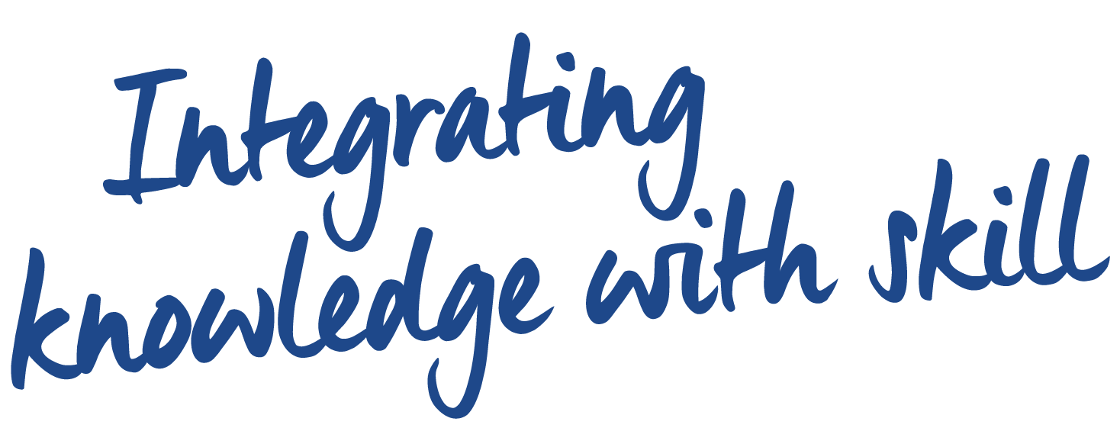
Mottomuz

Slide 5

THANK YOU

